Slide 1

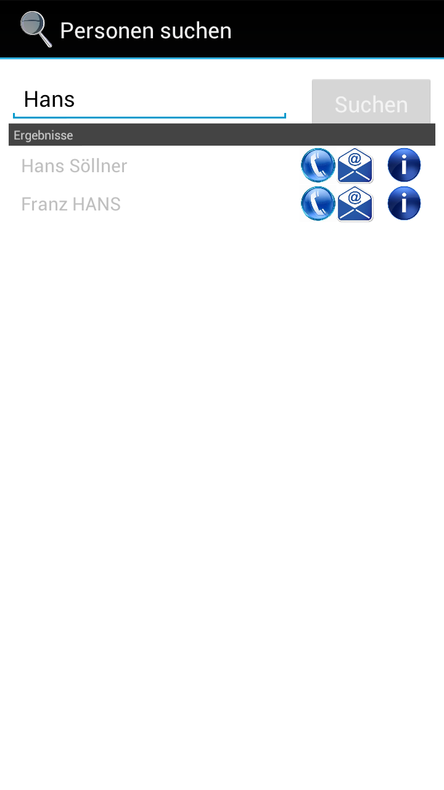
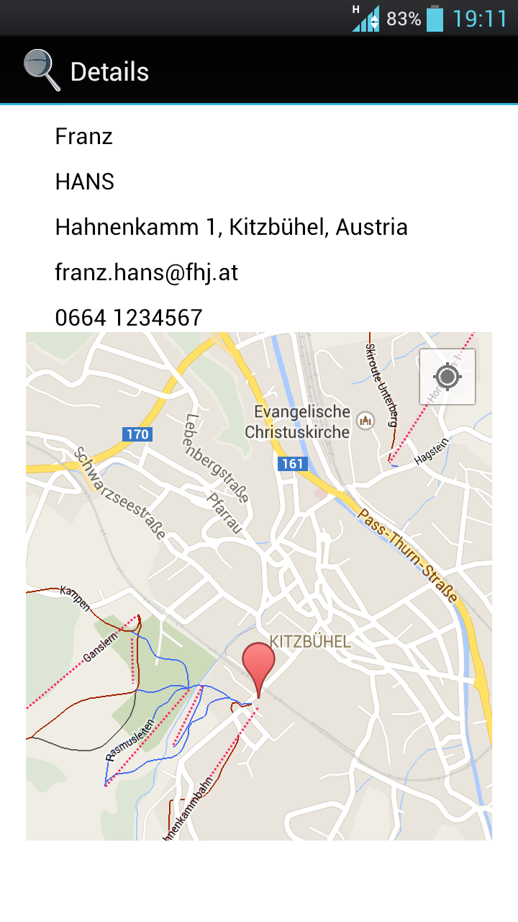
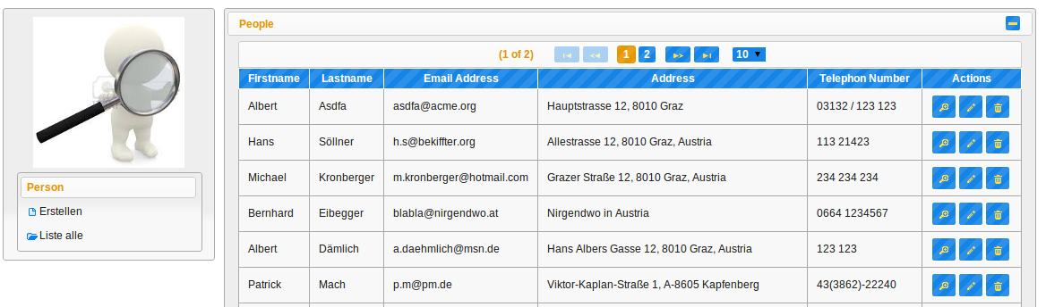
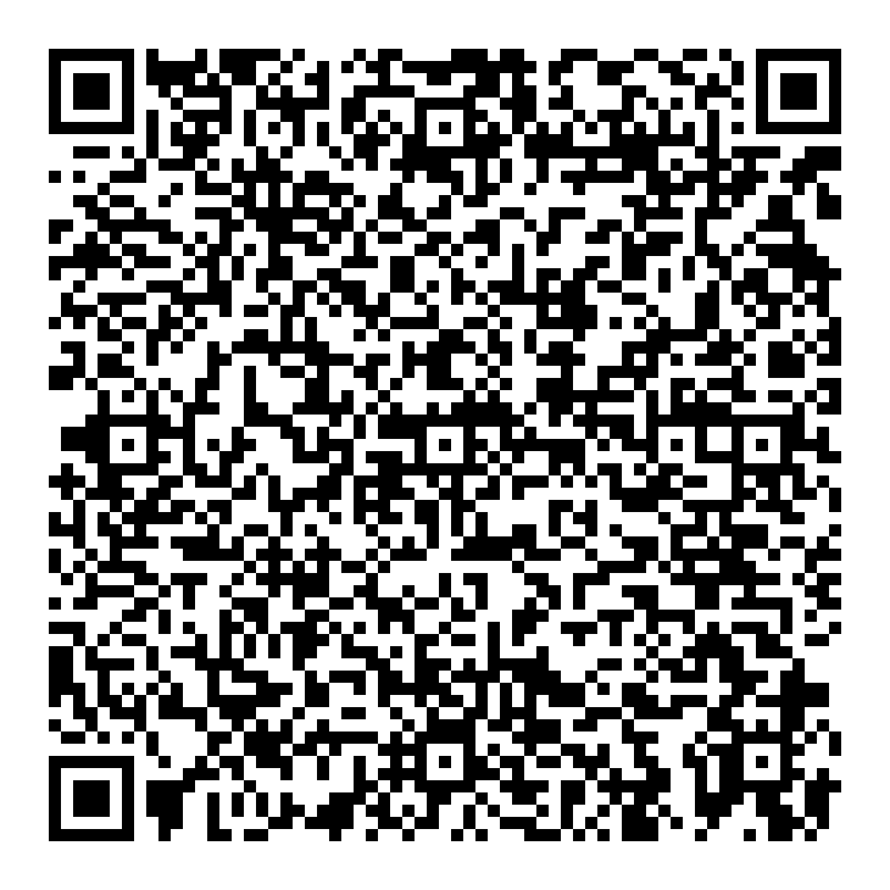
Advanced Security Engineering
Mobile Search for Employees
Mobile search for employees on the go and on your fingertips.
Supports various smartphones, full text search, interactive maps
…
Advanced Security Engineering
Werk-VI-Straße 46
8605 Kapfenberg, AUSTRIA
E-Mail: ase@fh-joanneum.at

